Slide 1
CSE/PC/B/T/316 Computer Networks Topic 6- MAC Controlled Access and Channelization
Sarbani Roy
sarbani.roy@jadavpuruniversity.in
Office: CC-5-7
Cell: 9051639328

Slide 2
Controlled Access
In controlled access, the stations consult one another to find which station has the right to send. A station cannot send unless it has been authorized by other stations. We discuss three popular controlled-access methods.
Reservation
Polling
Token Passing

Slide 3
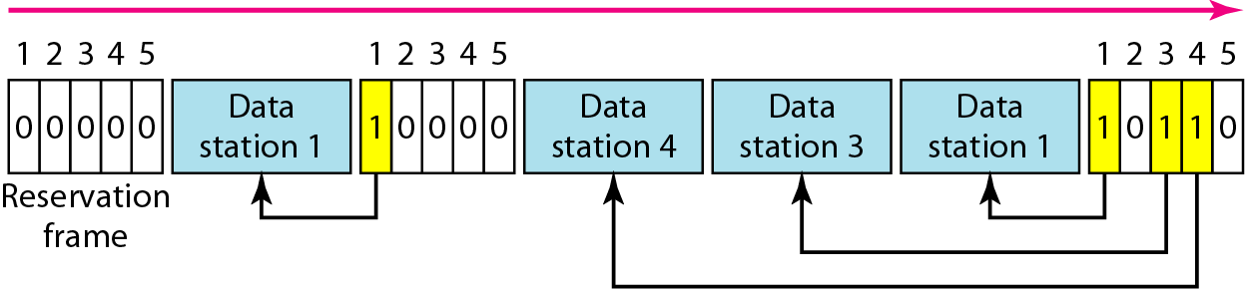
Reservation
In reservation method, a station needs to make a reservation before sending data. Time is divided into intervals. In each interval, a reservation frame precedes the data frames sent in that interval.
If there are N stations in the system, there are exactly N reservation minislots in the reservation frame. Each minislot belongs to a station. When a station needs to send a data frame, it makes a reservation in its own minislot. The station that have made reservations can send their data frames after the reservation frame.

Slide 4
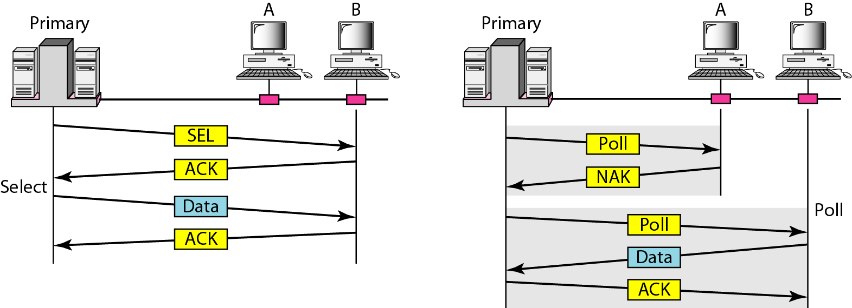
Polling
Polling work with topologies in which one device is designated as a primary station and the other devices are secondary stations.
All data exchanges must be made through the primary device; the primary device controls the link, therefore, it is always the initiator of a session.
Poll: If the primary wants to receive data, it asks the secondary nodes if they have anything to send.
Select: If the primary wants to send data, it tells the secondary nodes to get ready to receive.

Slide 5
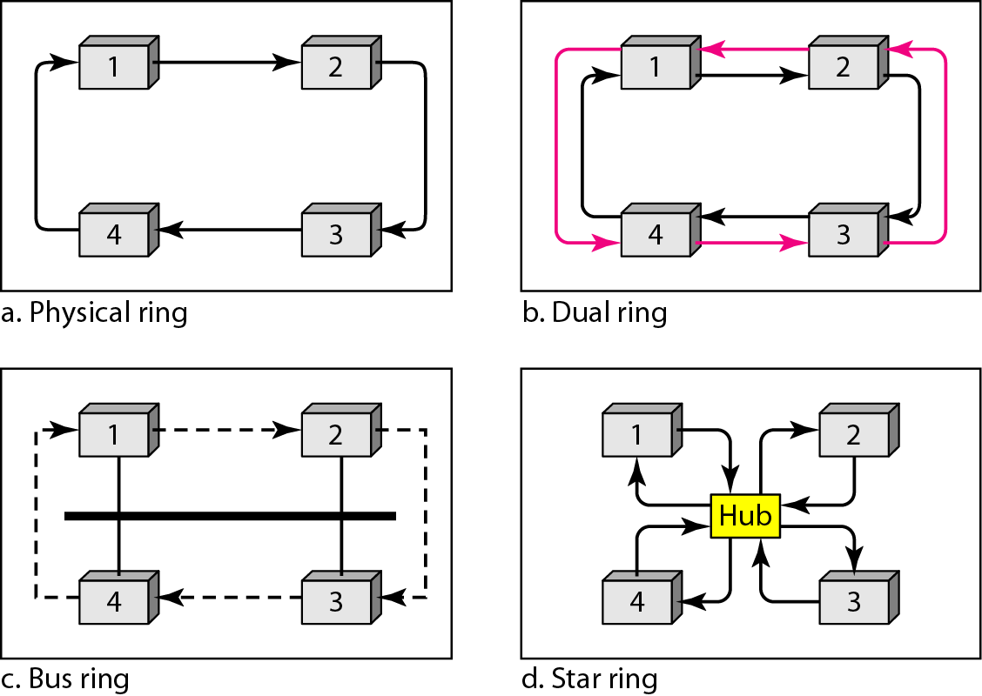
Token passing
In the token passing method, the station in a network are organized in a logical ring.
A special packet called a token circulates through the ring. The possession of the token gives the station the right to access the channel and send its data.
Token management is needed for this access method.

Slide 6
Channelization
Channelization is a multiple-access method in which the available bandwidth of a link is shared in time, frequency, or through code, between different stations. In this section, we discuss three channelization protocols.
Frequency-Division Multiple Access (FDMA)
Time-Division Multiple Access (TDMA)
Code-Division Multiple Access (CDMA)

Slide 7
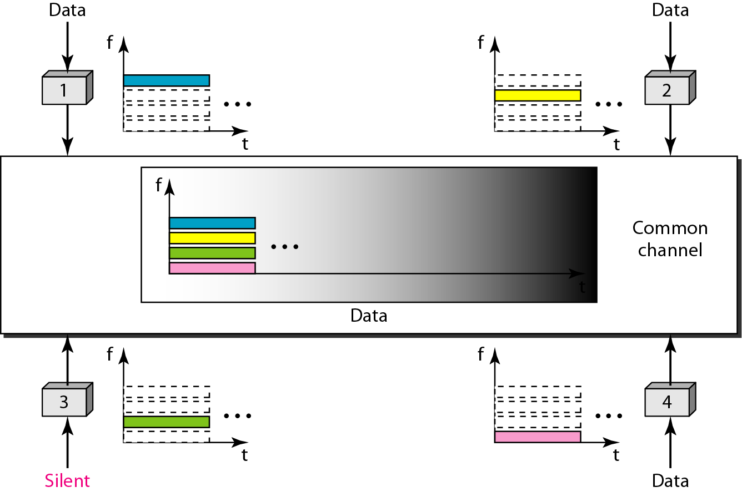
FDMA
In FDMA, the available bandwidth is divided into frequency bands.
Each station is allocated a band to send its data.
Each station uses a bandpass filter to confine the transmitter frequencies.
To prevent station interferences, the allocated bands are separated from one another by small guard bands.

Slide 8
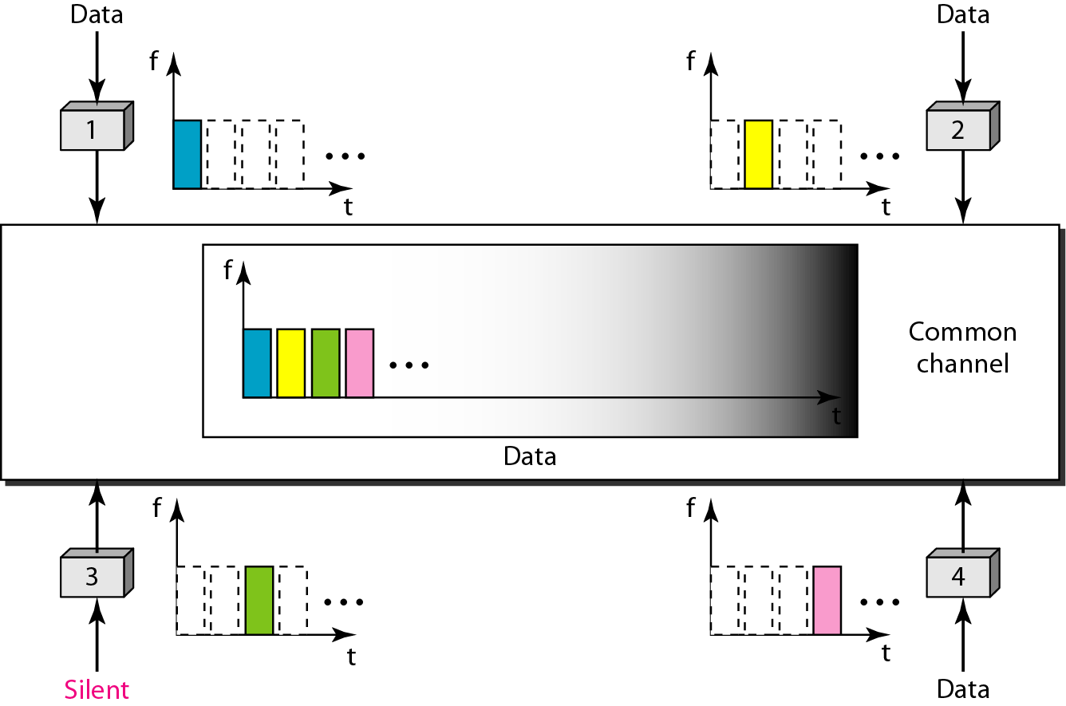
TDMA
In TDMA, the bandwidth is just one channel that is timeshared between different stations.
The main problem with TDMA lies in achieving synchronization between the different stations.
Each node needs to know the beginning of its slot and the location of its slot.
This may be difficult because of propagation delays if the stations are spread over a large area.

Slide 9
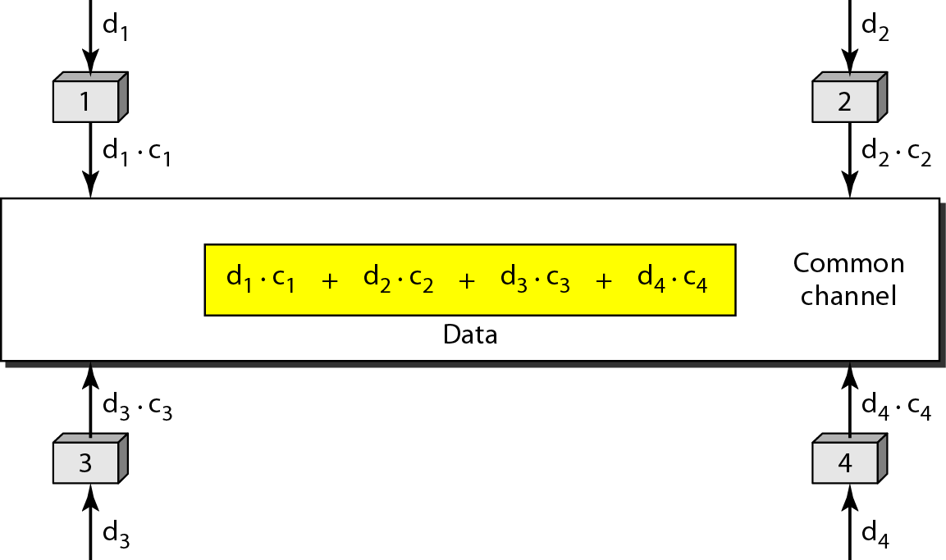
CDMA
CDMA was conceived several decades ago..with advancement on electronic technology recently implemented .
In CDMA, one channel carries all transmissions simultaneously.

Slide 10
Chip sequences

Slide 11
Data representation in CDMA

Slide 12
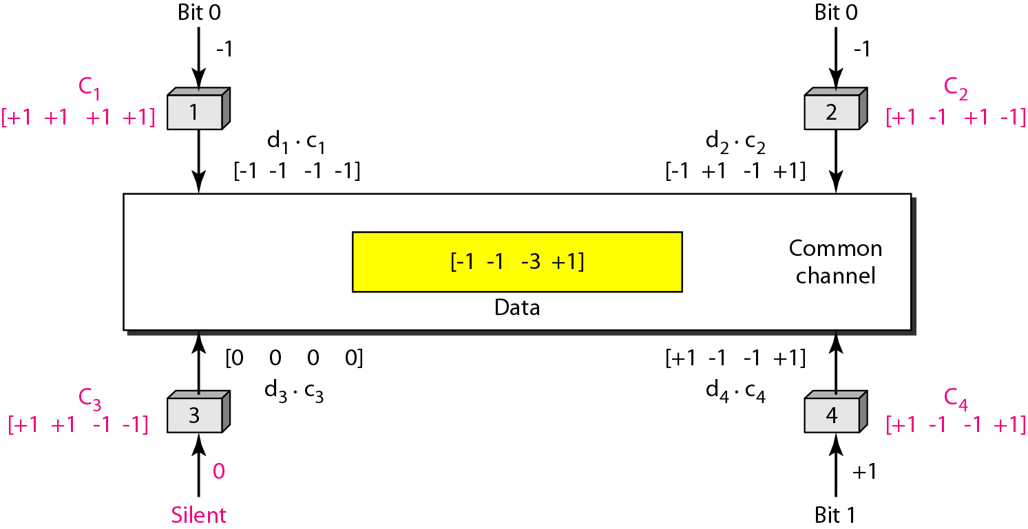
Sharing channel in CDMA

Slide 13
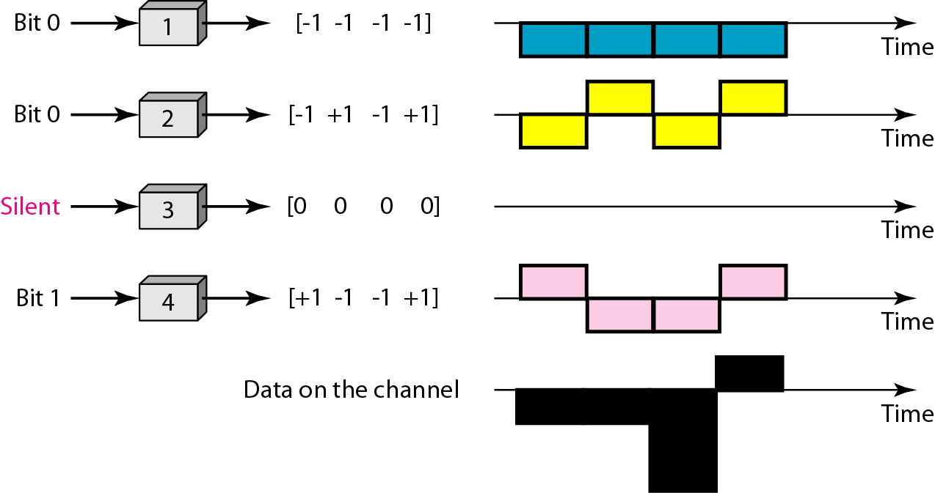
Digital signal created by four stations in CDMA

Slide 14
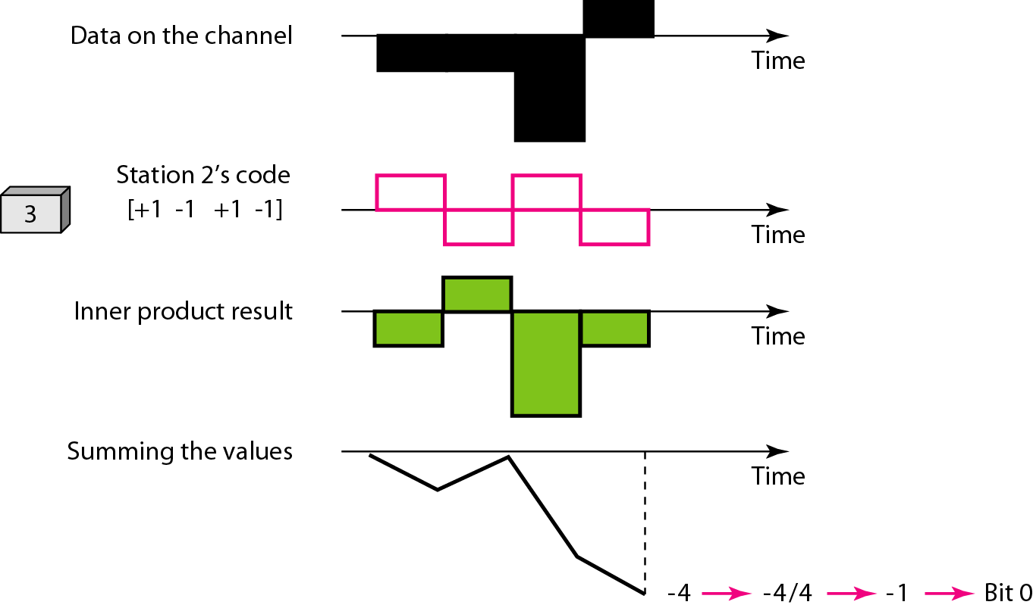
Decoding of the composite signal for one in CDMA

Slide 15
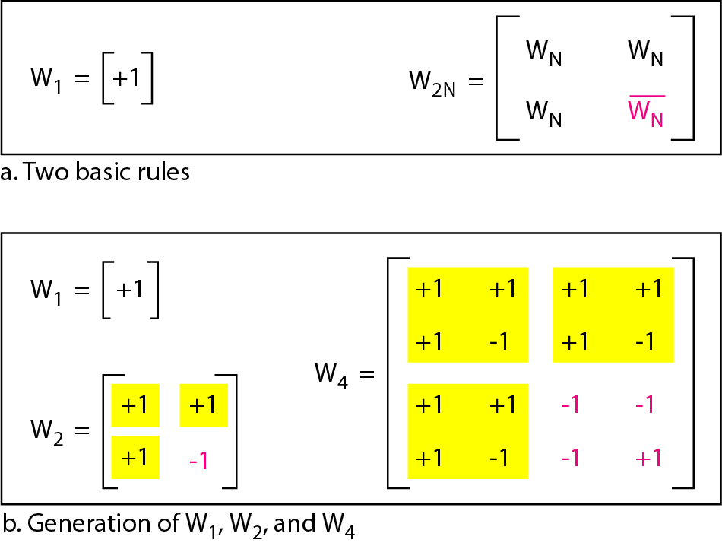
General rule and examples of creating Walsh tables

Slide 16
The number of sequences in a Walsh table needs to be N = 2^{m}.

Slide 17
Example
When we divide the result by N, we get d1 .

Slide 18
Problem
Find the chips for a network with
a. Two stations b. Four stations

Slide 19
Solution
Solution
a. For a two-station network, we have [+1 +1] and [+1 −1].
b. For a four-station network we have [+1 +1 +1 +1], [+1 −1 +1 −1], [+1 +1 −1 −1], and [+1 −1 −1 +1].

Slide 20
Problem
What is the number of sequences if we have 90 stations in our network?

Slide 21
Solution
Solution
The number of sequences needs to be 2^{m}. We need to choose m = 7 and N = 2⁷ or 128. We can then use 90 of the sequences as the chips.

